Slide 1
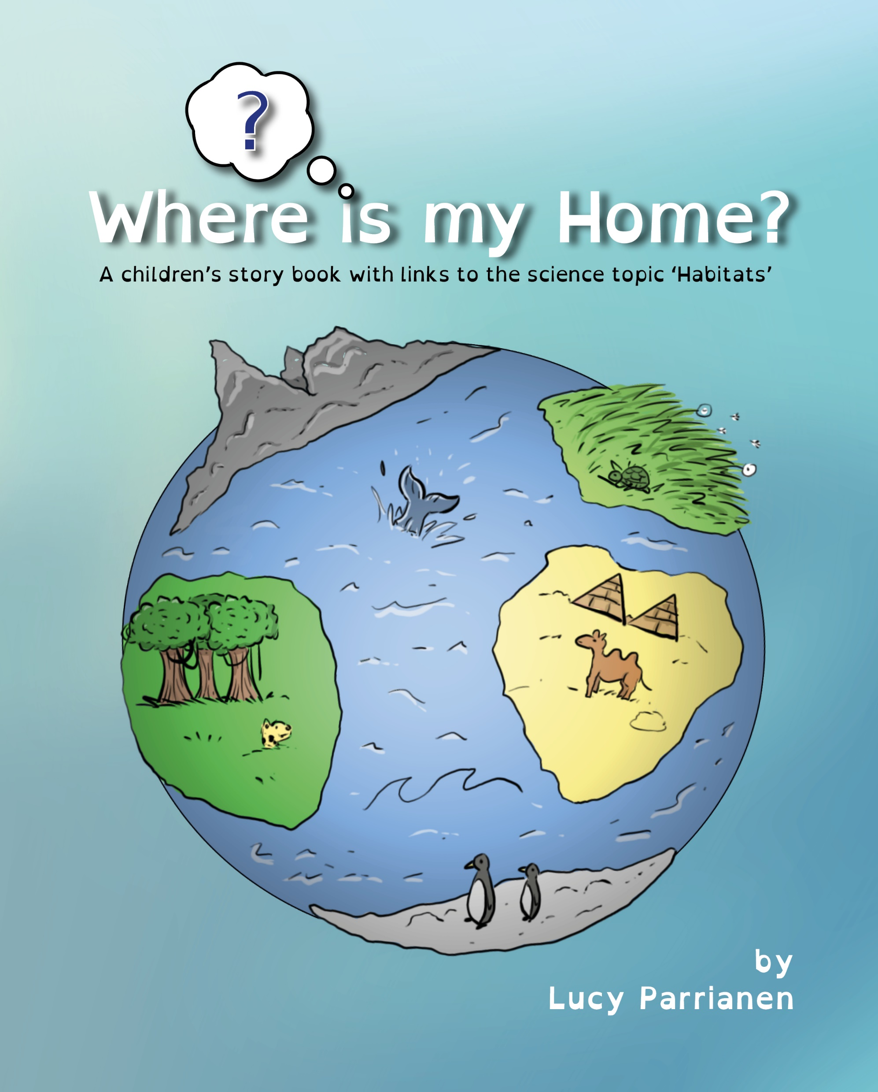
Habitats Topic
By Lucy Parrianen
Widgit symbols used throughout – see copyright

Slide 2
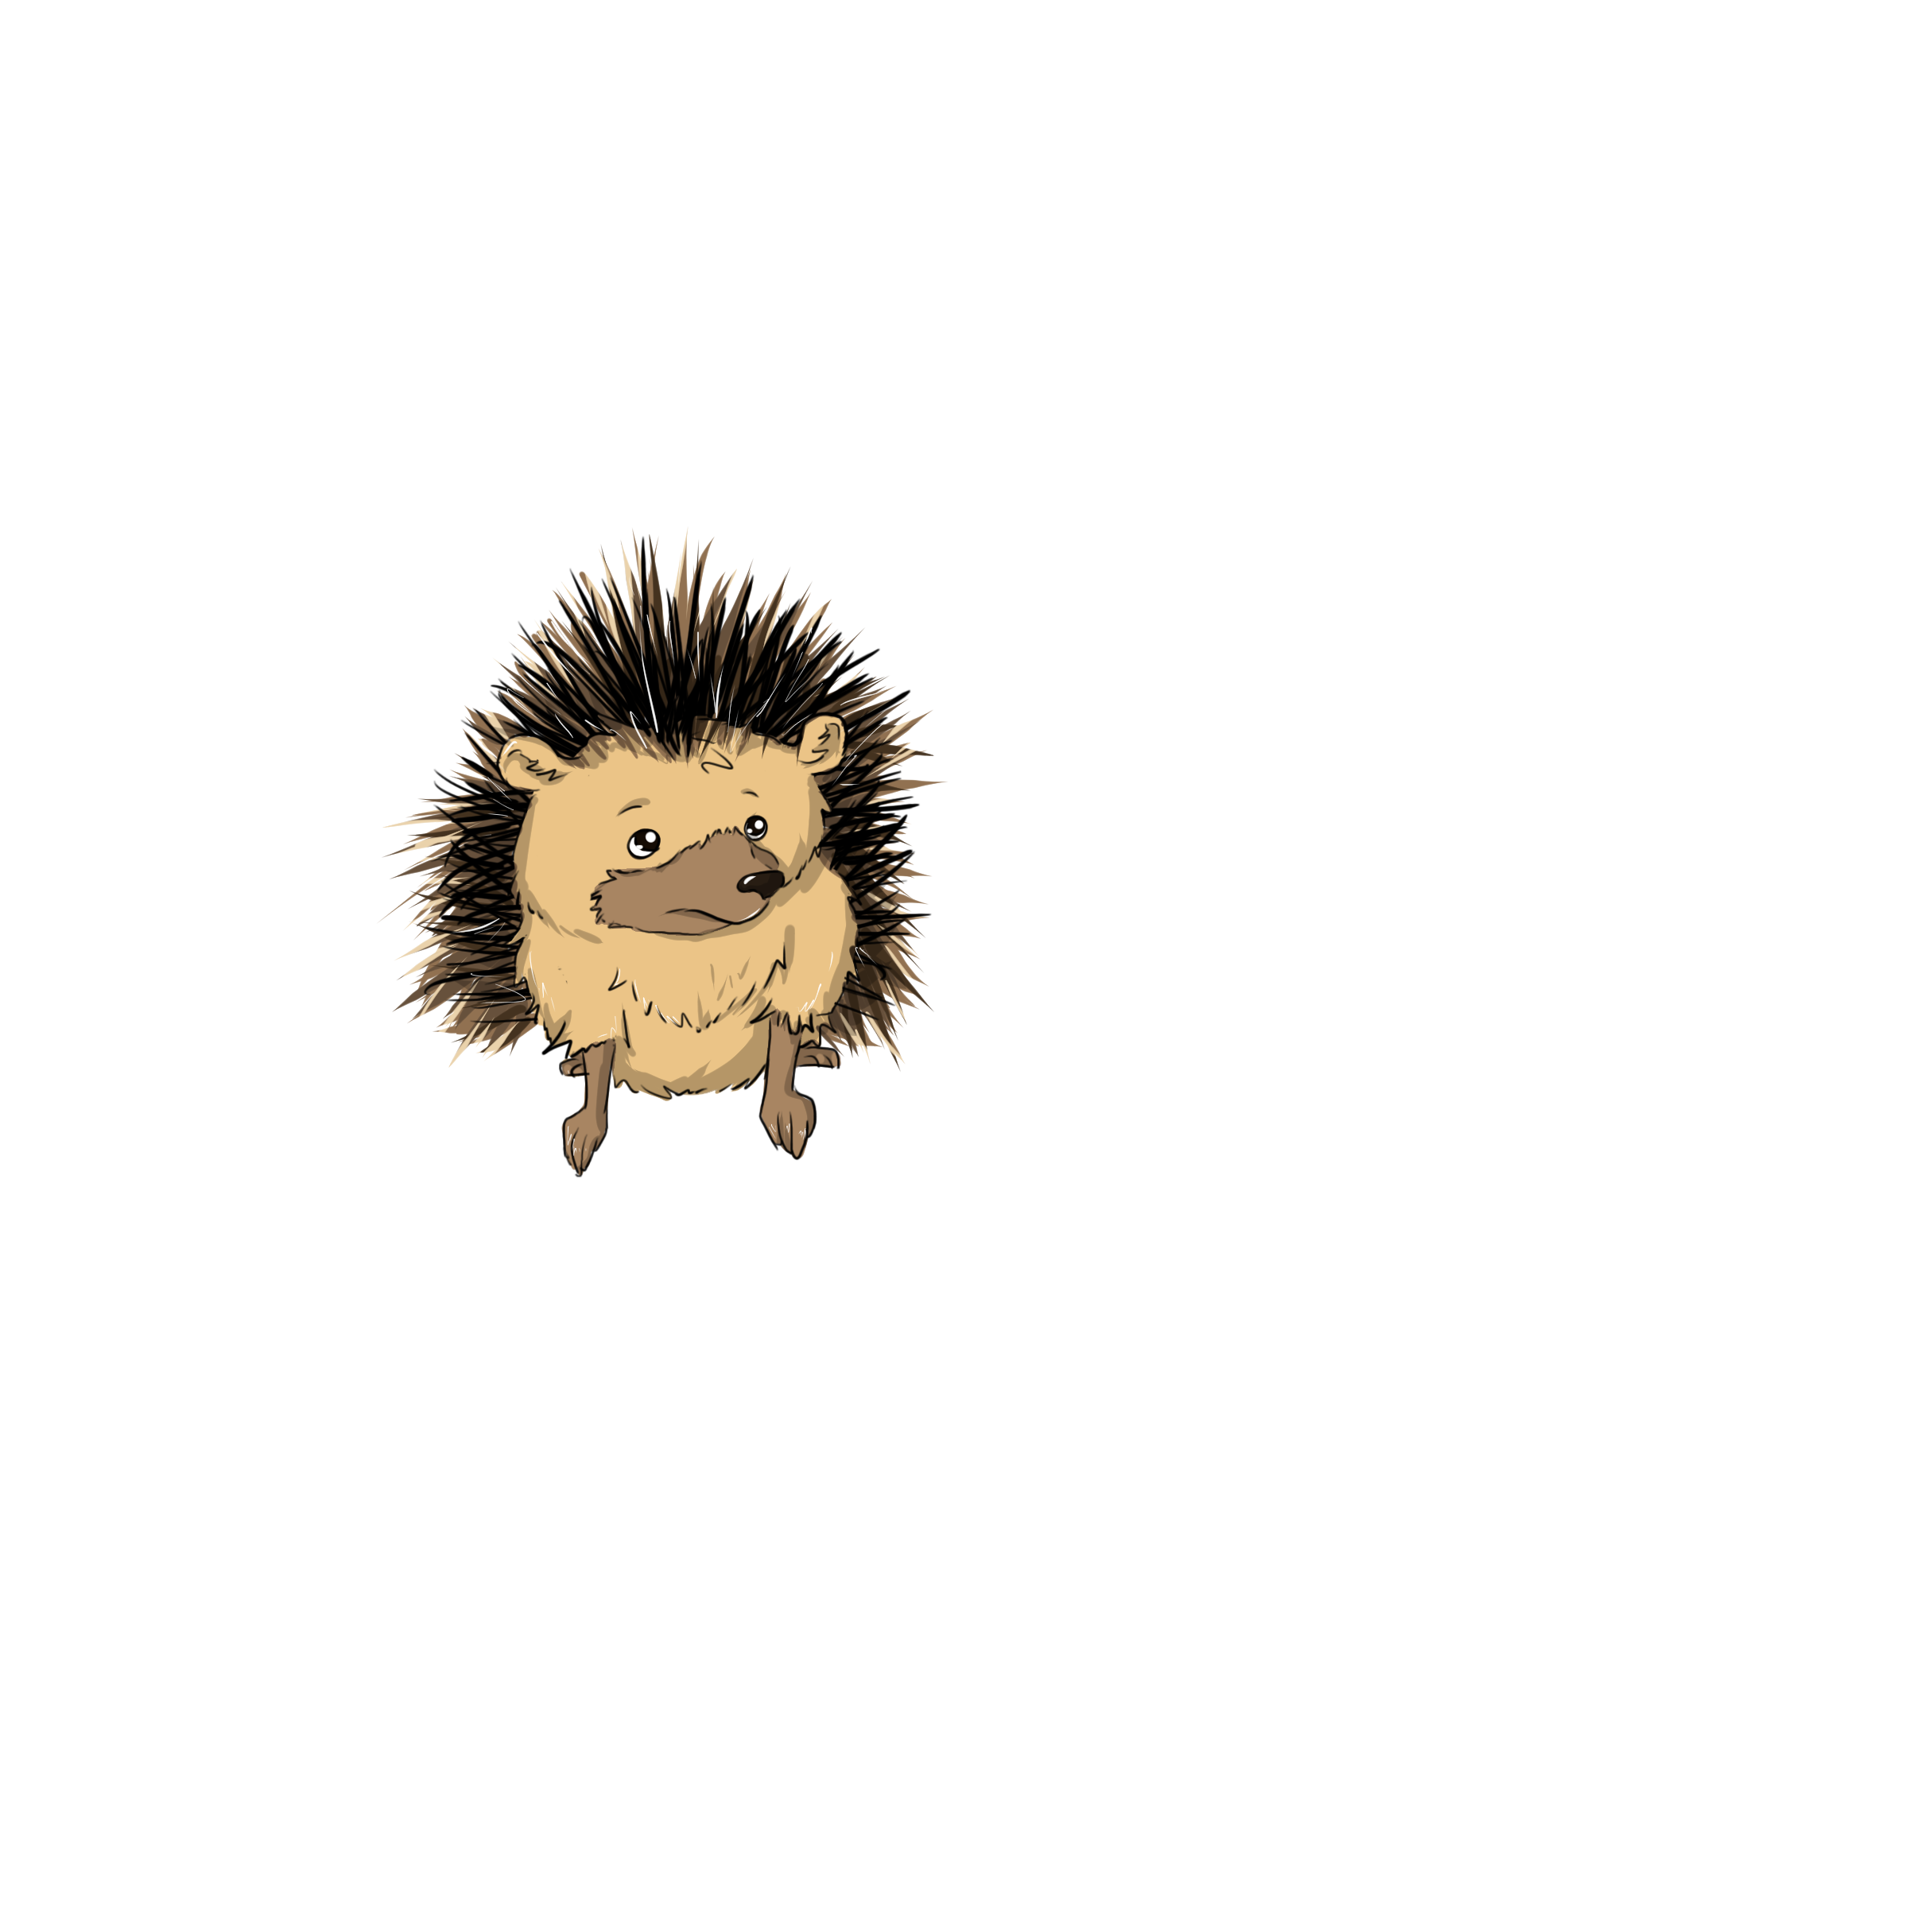
Lesson 1
LO: To learn what a woodland
habitat is like and
animals that live there.
Key questions:
Has anyone ever visited this habitat? What did you see? What kinds of plants and animals? Can you name any? Discuss the word ‘woodland’ – what does this tell us about the habitat? What do you know about woodlands?

Slide 3
Lesson 1
LO: To learn what a woodland
habitat is like and
animals that live there.
our book focus
Research
As a class, we are going to research woodland habitats. We want to find information about the conditions, temperature, plants, trees and creatures that live there. We want to find some woodland areas on a map and see what they look like.

Slide 4
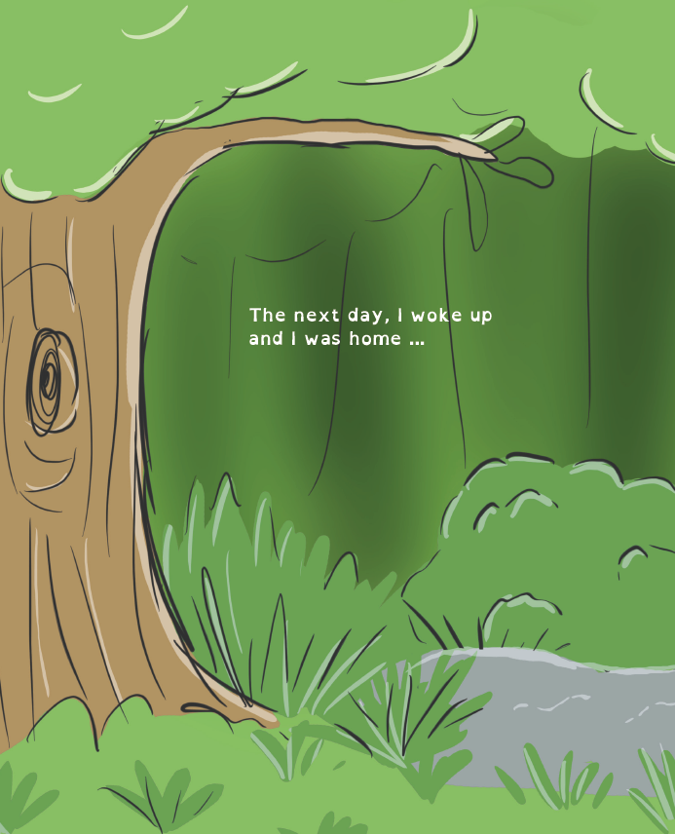
Think about your 5 senses. What would it feel like to be in the woodland habitat?

Slide 5
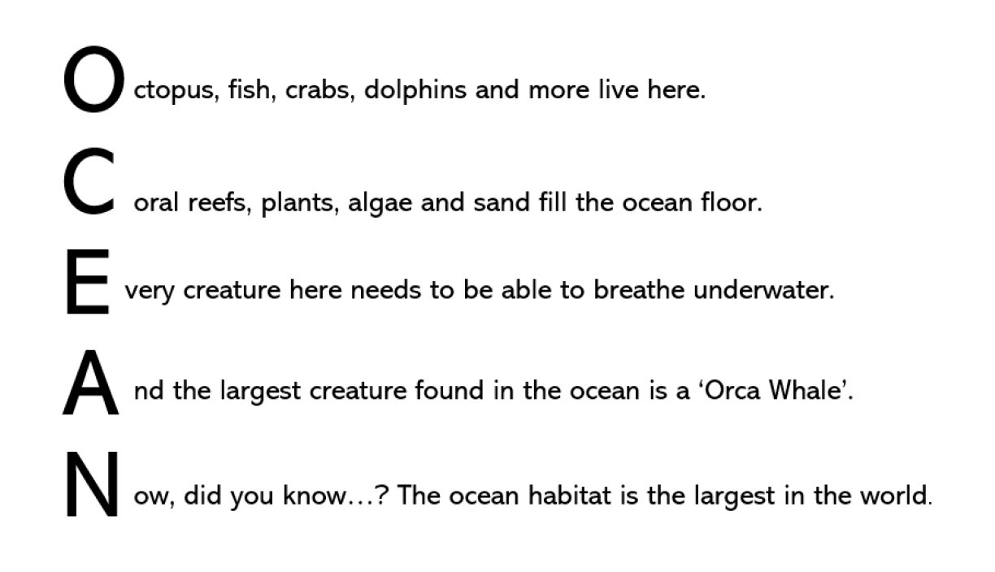
Lesson 1
Activity
Create an acrostic poem with the facts and knowledge you have about the woodland habitat.
See the example here:

Slide 6
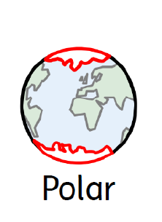
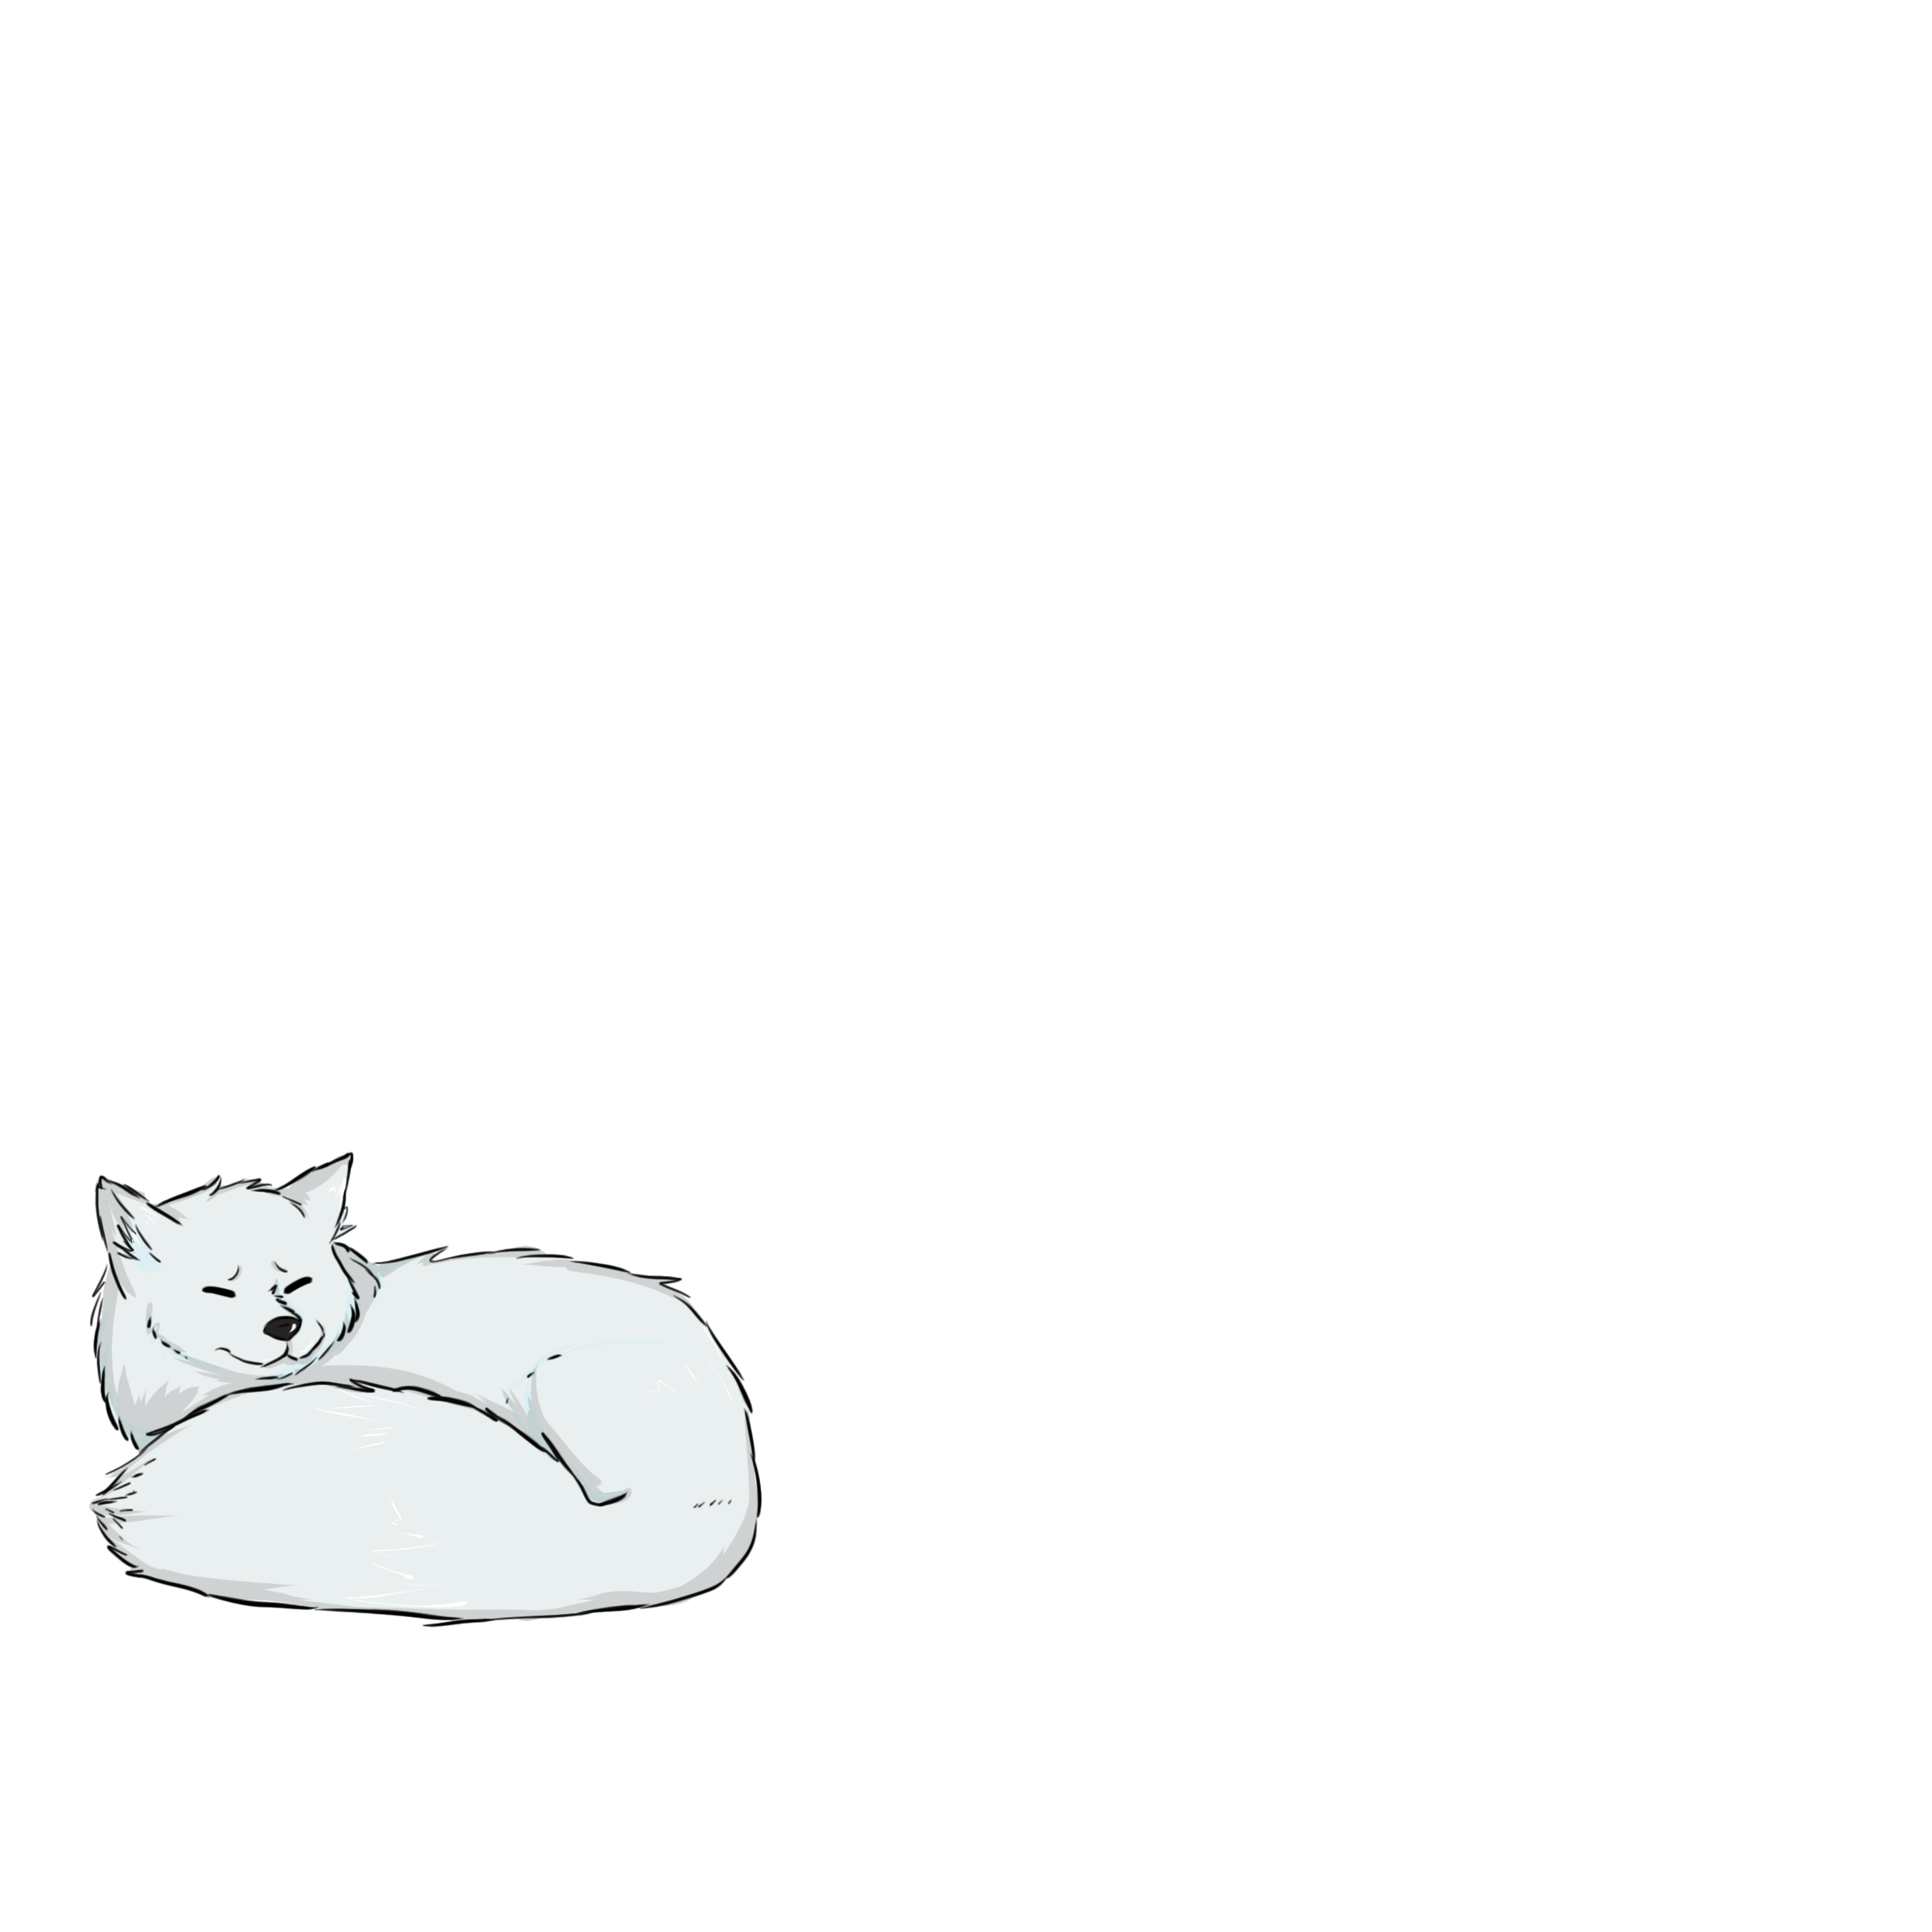
Lesson 2
LO: To learn what a polar
habitat is like and
animals that live there.
Key questions:
What does it look like? How would it feel? What might we need to wear there? Do you know where to find these polar areas on a globe?

Slide 7
Lesson 2
LO: To know what the polar habitats are and where they are located.
Why are some areas highlighted in red?
Explain where the polar regions are on the globe. There is the North Pole and South Pole (Artic and Antarctic).
Polar regions present different challenges to animals and plants – animals have adapted to survive here. Plants grow close to the ground to avoid the cold, harsh wind; and animals grow thick layers of fat or fur as protection from freezing temperatures.
Talk to your child about what animals need that live here and how they get it (shelter, food etc.) Some animals make burrows under the snow to get away from the icy winds. Most animals here eat fish or creatures in the ocean as this is the only food available to them.

Slide 8
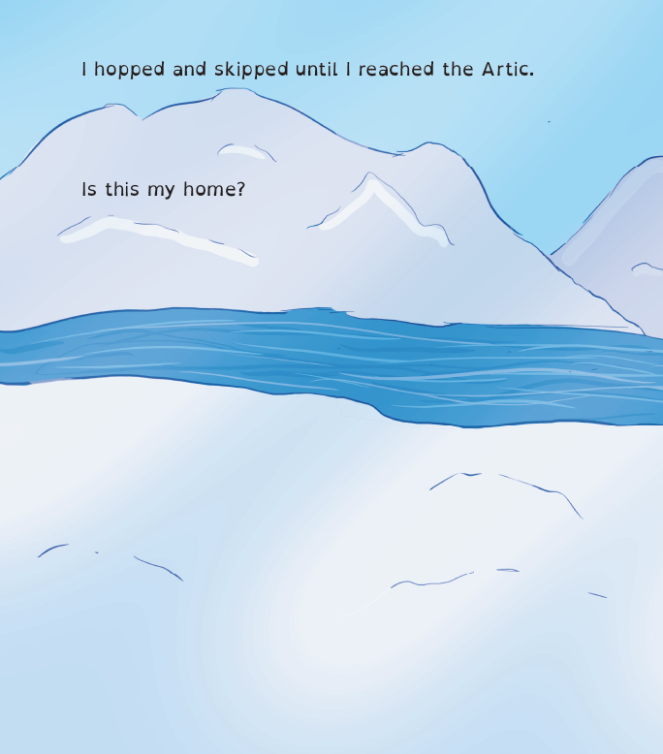
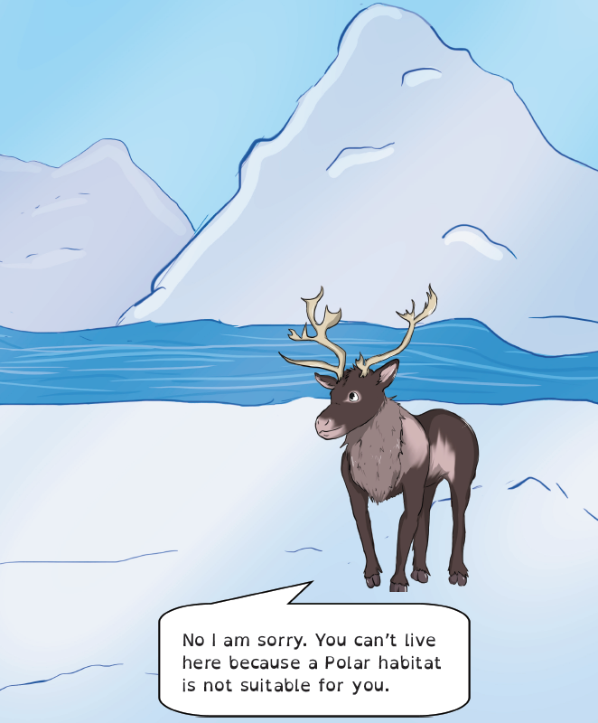
What can you see here?
Try and think of some new adjectives
e.g.
Icy, frozen, thawed

Slide 9
Lesson 2
Activity
temperature
conditions
harsh
Activity:
Write a postcard (pretending that you are on holiday in the Artic).
Describe what the area is like and animals/creatures you have seen. Try and use lots of adjectives and interesting vocabulary.
Use some of the keywords to help you with spellings.
Snow
Ice
burrow

Slide 10
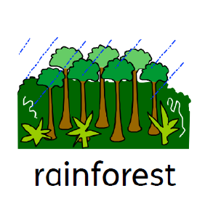
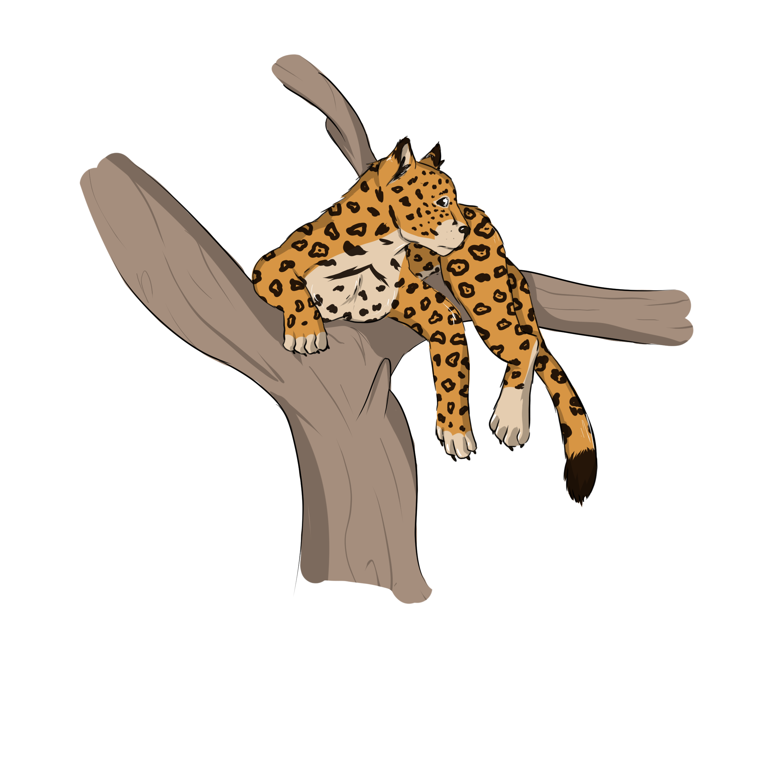
Lesson 3
LO: To learn what a rainforest is and the creatures/plants that live there.
Key questions:
Do you know what a rainforest is? What are layers? Why do you think there are layers? Why is it called the ‘rain’ forest? What do you think it is like there? What animals do you know that live there?

Slide 11
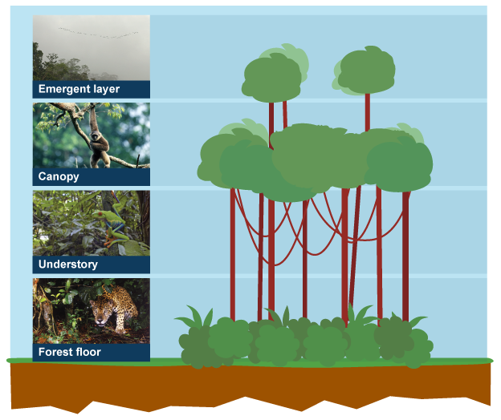
Lesson 3
LO: To learn what a rainforest is and the creatures/plants that live there.
Explain that animals in the rainforest can live on the floor, understory, canopy or emergent layer.
Explain that birds live high in the emergent layer to be able to stay safe.
Leopards and big cats live on the forest floor as they can’t climb trees.
Some animals may go between the layers, for example, a monkey will travel between layers as they swing through the forest.
Copyright – BBC
https://www.bbc.co.uk/bitesize/guides/zpmnb9q/revision/1

Slide 12
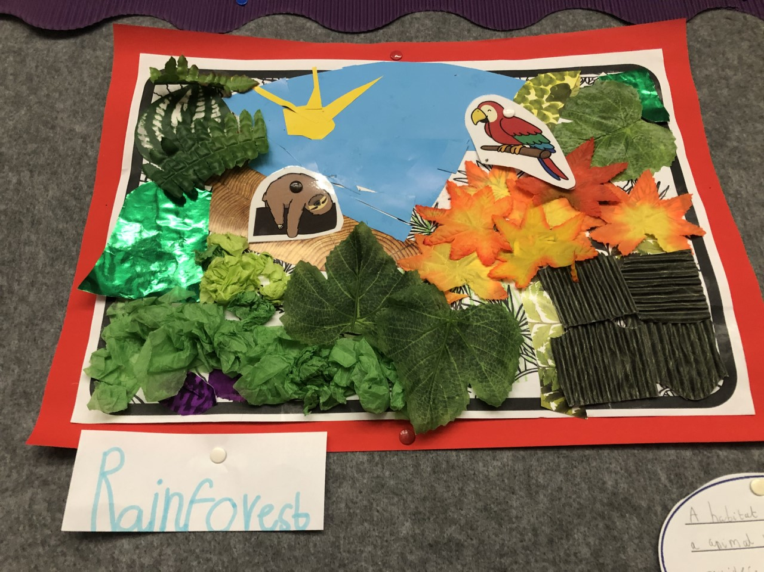
Lesson 3
Activity
Activity (ART) :
Create the rainforest background using crayons, paints, pencils, pens or collage materials. See example. (using Twinkl animal picture cards)
Once you have finished, print off the free colouring sheets on the website (https://www.lucyparrianenauthor.com/) to recap some of the other habitats that you have explored.
Copyright: Twinkl (animal picture cards )
https://www.twinkl.co.uk/

Slide 13
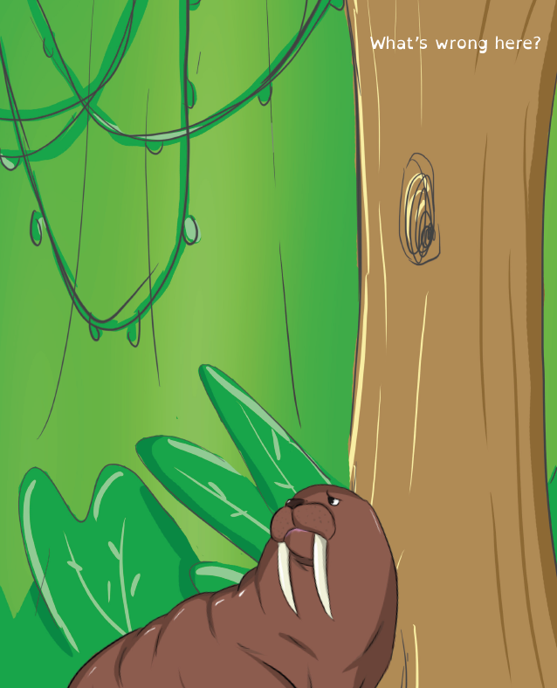
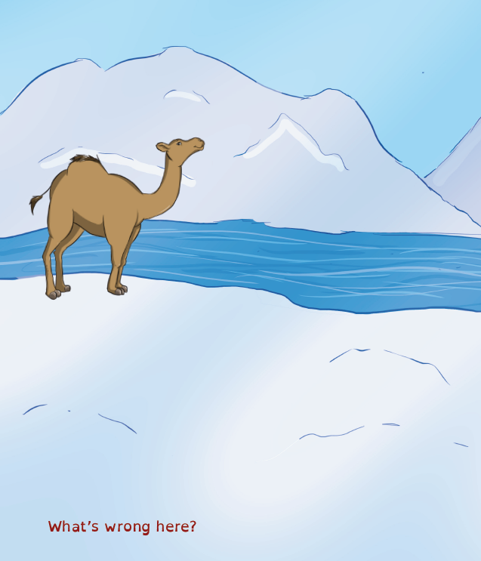
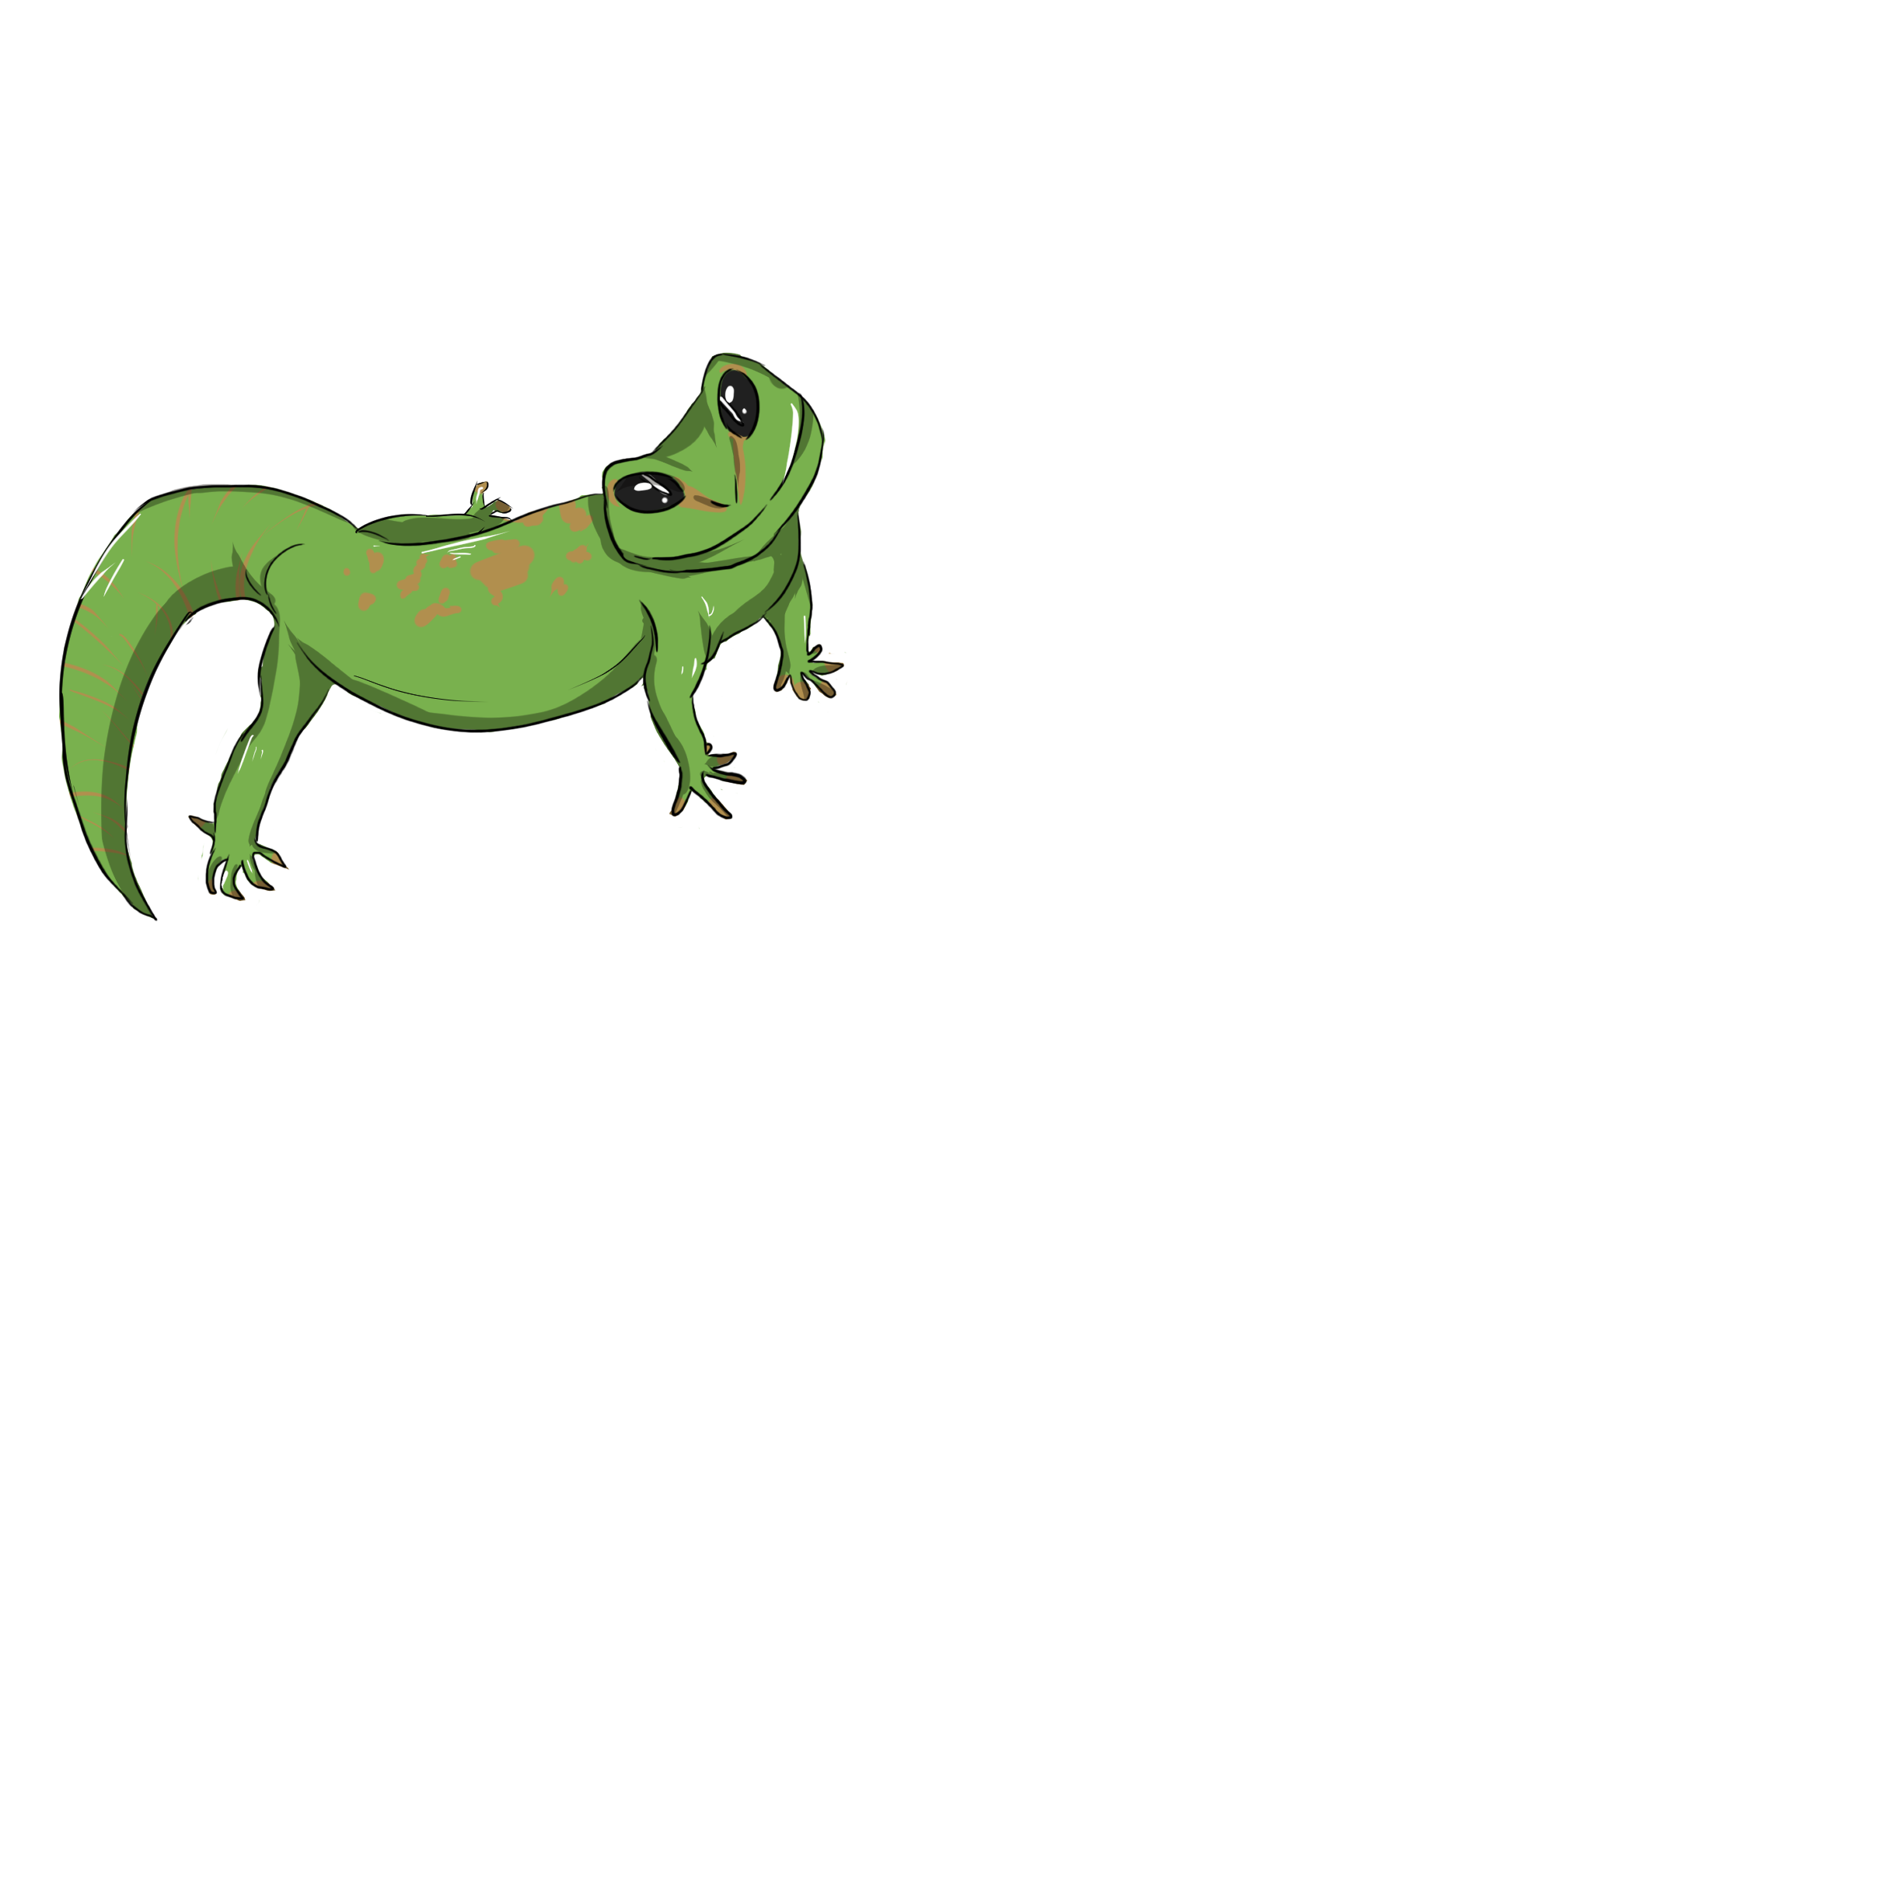
Lesson 4
LO: To apply habitat knowledge to ‘what’s wrong?’ pictures.
Using the knowledge you have learnt during this ‘habitats’ topic.
Look for the problem with these pictures.
What’s wrong here?

Slide 14
Lesson 4
Activity
Write clear sentences giving reasons about what is wrong in the picture and why.
EXAMPLE:
‘I know the walrus can not live in the rainforest because he needs to be in a cold habitat. The walrus needs to be near water as they eat fish. There is no food for the walrus in the rainforest’.
Challenge: What other animals can not survive in these habitats? Try and create your own – you could draw a monkey in the Artic!!

Slide 15
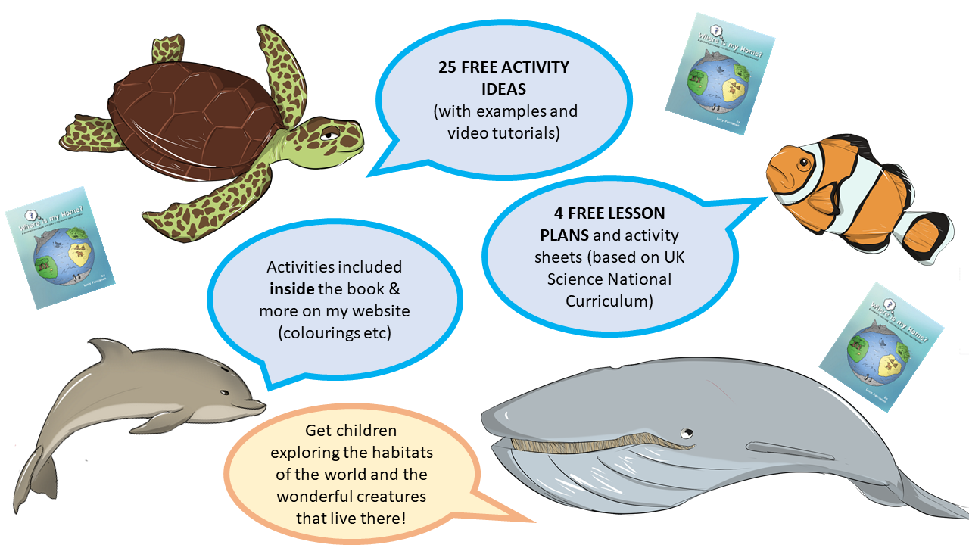
More activities and ideas: lucyparrianenauthor.com
Any questions or for more information contact: whereismyhabitat@outlook.com
Symbols created using Widgit online: Widgit Symbols © Widgit Software 2002 – 2020

